Slide 1
CodeX and ASCII Art

Slide 2
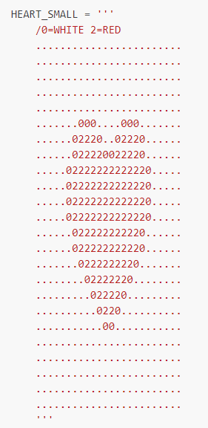
Built-in Images
Built-in images are called ASCII Art
  They are bitmap images
  https://docs.firialabs.com/codex/gallery.html
  https://docs.firialabs.com/codex/ascii_art.html
  Each image is 24x24
  Scale to 10 for 240x240

Slide 3
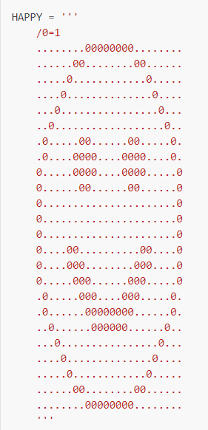
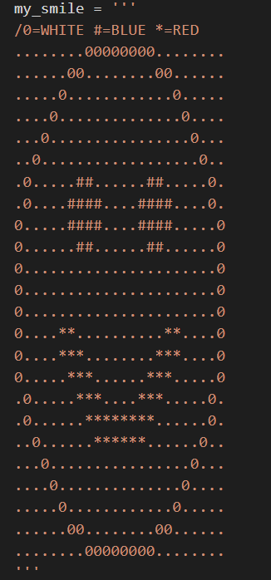


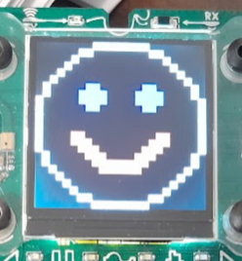
Making your own ASCII Art
Experiment with re-doing a built-in image

Slide 4


Making your own ASCII Art
Start a new file in CodeSpace (use the sandbox)
Import these modules:
Create a variable for your image (should be descriptive)
  Use 3 single quotes ‘’’ to define the ASCII image.

Slide 5
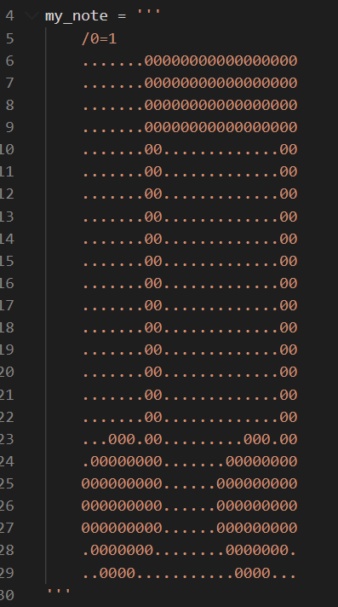
Making your own ASCII Art
Go to the gallery
https://docs.firialabs.com/codex/gallery.html
Select a built-in graphic, like the music note
Copy and paste the code into your new program

Slide 6
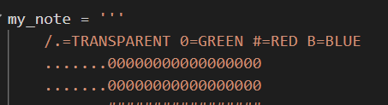
Making your own ASCII Art
The first line in the image defines the colors used and the symbol for each color.
The symbol can be a number, letter, or character.
Change the first line to add more colors (use as many as you want).
You can also use a symbol for TRANSPARENT

Slide 7
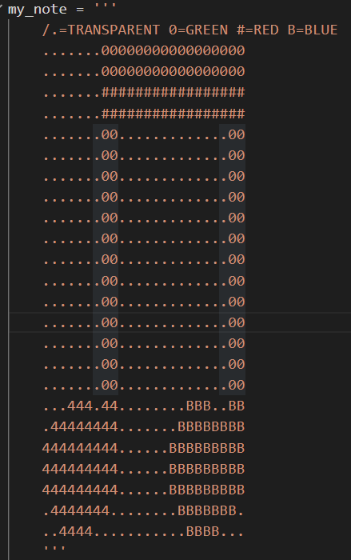
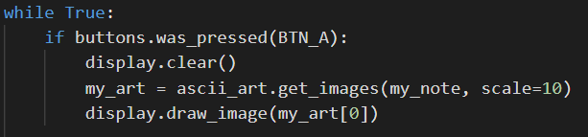
Making your own ASCII Art
Then change some of the 0 to add color to the music note.
Add this code and press BTN_A to see your modified music note!

Slide 8

Make your own ASCII Art
Find a pixel art image from the Internet
One thing to remember is this art is by COLOR, not character. Use a search like “simple pixel art”.
Try this simple graphic
  12 x 9
  Use three colors

Slide 9
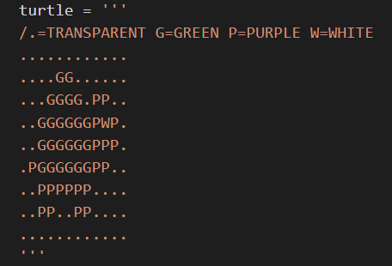
Making your own ASCII Art
Before you start the art, choose symbols for each color.
This is the “key” to the art.
The symbol can be:
  A character
  A letter
  A number

Slide 10
Making your own ASCII Art
Then start with the first row.
In our image, each row has 12 boxes, or pixels.
Each one must be represented either with . for transparent, or the symbol that represents the color.

Slide 11
Making your own ASCII Art
Finish the image by completing the rows
Each row needs to be the same size

Slide 12
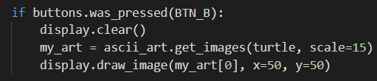
Making your own ASCII Art
Use code to display the image.
  You may need to play around with the scale.
  You can move the image by changing the x and y position

Slide 13
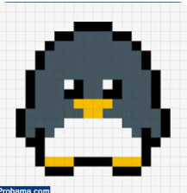
Making your own ASCII Art
Another simple bitmap image:
You can create your own bitmap image!
If you search for one, don’t look for ASCII art.
This is really a bitmap, or “simple pixel art”.

Slide 14
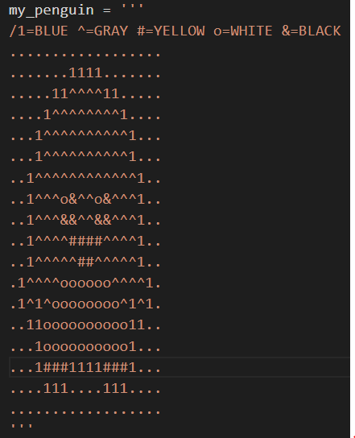
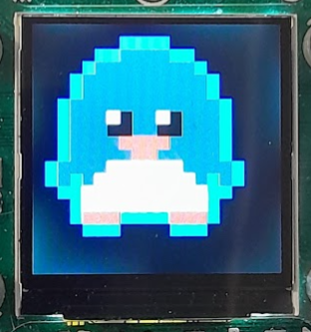

Another example:
Another simple bitmap image:

